Slide 1


Style Transformation Method of Stage Background Images by Emotion Words of Lyrics
Master Thesis
Dept. of Multimedia Engineering, Dongguk University-Seoul
Master Course
Hyewon Yoon
Supervisor. Professor Yunsick Sung
Notes:
강의를 시작하도록 하겠습니다.
2장 Performing operations

Slide 2
AGENDA
Introduction
Related works
Image style transformation method
Experiments
Conclusion
Reference

Slide 3
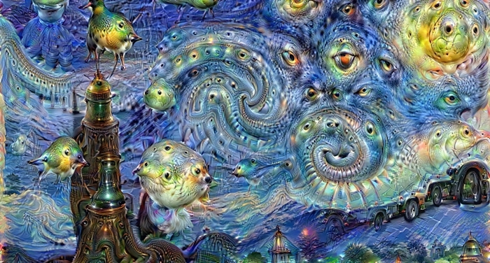
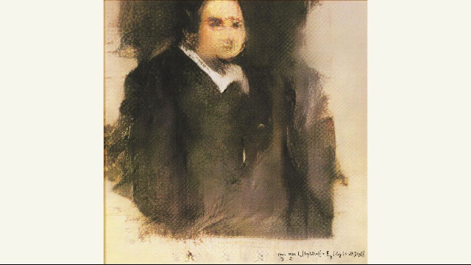
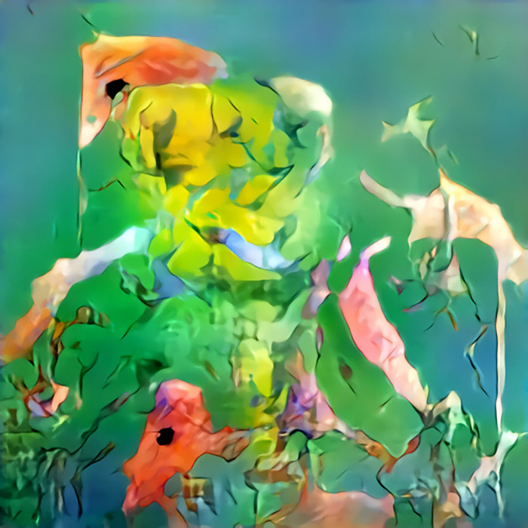
1. Introduction (1/4)
1.1 Research goal and necessity
Domain/Fields
In recent years, Artificial Intelligence(AI) has been studied in the art field, which requires creativity, an inherent ability of humans[1-3].
Deep dream painting
Portrait based Generative Adversarial Networks (GAN)
Abstract painting based CAN
Notes:
본 강의는 다음과 같은 교재를 기반으로 구성되었습니다.

Slide 4
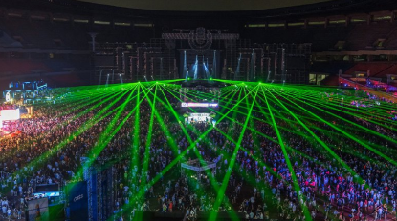
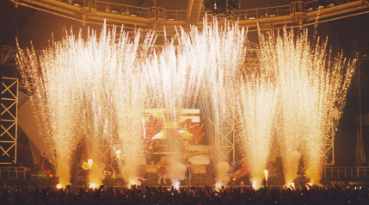
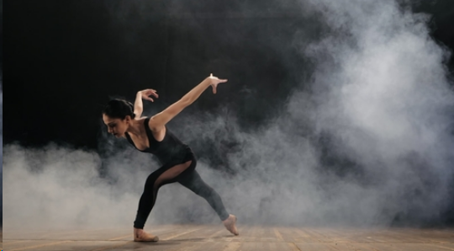
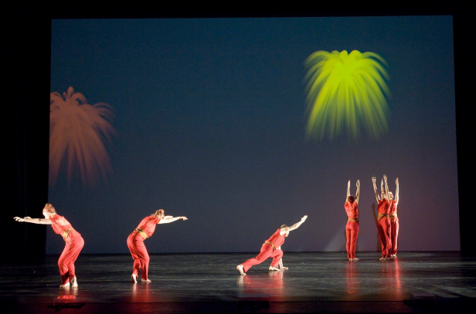
1. Introduction (2/4)
1.1 Research goal and necessity
Domain/Fields
The art field has been integrated with various industrial fields, such as AI, which is used in stage art in combination with stage effects.
Lightening
Firework
Smog
Background Image
Notes:
본 강의는 다음과 같은 교재를 기반으로 구성되었습니다.

Slide 5
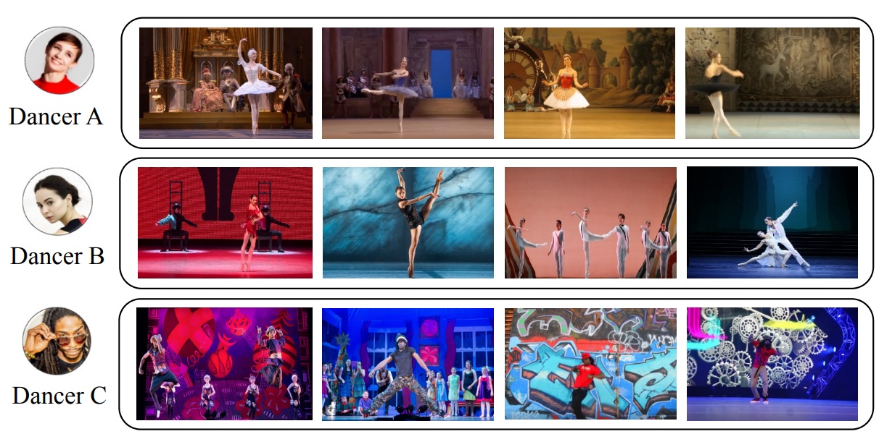
1. Introduction (3/4)
1.1 Research goal and necessity
Issues
Stage background image recommendation system is used to automatically compose stage background images according to dance styles without professional stage designers[4].
Problems
However, the limitation of the stage background images selected through conventional recommendation systems is that the emotions to be represented in the song lyrics are not reflected in the stage performance.
…
…
…
…
…
Notes:
본 강의는 다음과 같은 교재를 기반으로 구성되었습니다.

Slide 6
1. Introduction (4/4)
1.2 Method and contributions
Proposed method
This paper proposes a method to transform the multiple styles of stage background images based on the emotion words contained in verses and choruses of selected lyrics by a user.
Through the proposed method, the appropriate stage background images can be used for stage performance using the lyrics without designers.
Contribution
The audience immersion can be increased by using stage background images to represent emotions expressed in the song lyrics used for singing in stage performances. Emotions that are complex to represent using computers can be represented.
Certain emotions that are difficult for humans to determine intuitively can be represented as images because the proposed method can transform the style of images based on an image with a high correlation with the emotion represented using lyrics.

Slide 7
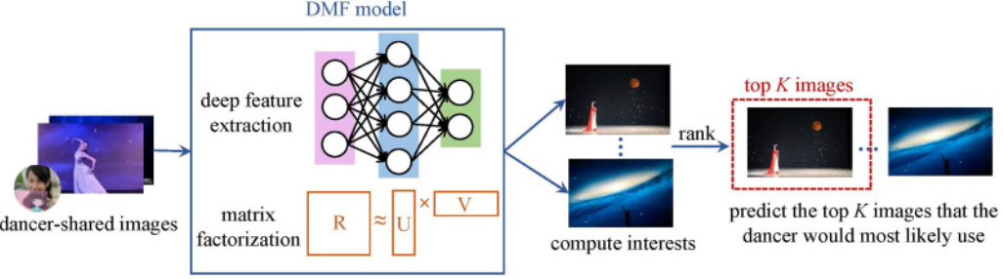
2. Related works (1/4)
2.1. Stage background image recommendation system
Purpose
A stage background image recommendation system[4] recommends stage background images by reflecting a dancer’s preferences and dance styles such as ballet, belly dance, street dance, modern dance, tango, and waltz.
Problem
Because only dances are reflected, the stage background images recommended by the stage background recommendation system do not represent the emotions that the singing stage performance aims to express through lyrics.

Slide 8
2. Related works (2/4)
2.2. Emotion classification
Purpose
To express emotions in images that are difficult to process using computers, studies have been conducted recently to improve the accuracy of the sentimental understanding of human emotions[12-18].
Problem
Because it is not possible to visualize the features of images classified with the level of basic emotions, there is no way of knowing the images that are appropriate for the stage background.
Emotion Words
Positive
Anticipation
Joy
Trust
Surprise
negative
Anger
Disgust
Sadness
Fear

Slide 9
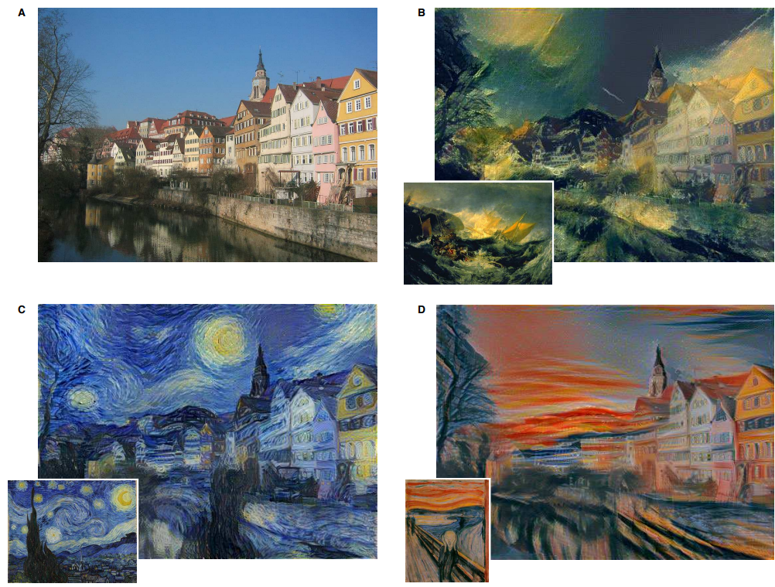
2. Related works (3/4)
2.3. Style transfer
Purpose
Style transfer transforms the style based on a convolutional neural network (CNN) [10-11] and a generative adversarial network (GAN) [5-7].
Problem
When transforming the style, content information may be lost.
Preprocessing is required for use in specific fields.

Slide 10
2. Related works (4/4)
2.4. Comparison methods for image style transformation
<Table 2-1> The difference between previous research and the proposed method
Research Contents | Zhao et al. [12] | Machajdiket al. [13] | Zhao et al. [17] | Proposed Method
Training Data | IAPS, Art Photo, Abstract Painting | IAPS, Art Photo, Abstract Painting | IAPS, Art Photo, Abstract Painting | Song lyrics, Stage Background Image
Encoding | Image -based | Image -based | User’s Metadata-based | One-hot encoding Texture-based
Learning Model | SVM | Waterfall Segmentation Algorithm | Multi-Task Hypergraph Learning | CNN

Slide 11
3. Image style transformation method (1/8)
3.1. Overview
The proposed method consists of the lyrics preprocessing step, which extracts the probability distribution of emotion words for each verse and chorus from selected lyrics, and the emotion image processing step, which transfers the styles for each verse and chorus images related to the extracted probability distribution of emotion words.
Emolex (Emotion Dictionary)
The Proposed Method
Step 1: Lyrics Preprocessing
User ’s Selected Lyrics
Sentence Divider
Sentences
Verse/ Chorus Extractor
Verses/ Choruses
Probability Distribution of Emotion Word Extractor
Step 2: Emotion Image Processing
Emotion Images with Tags
Probability Distributions of Basic Emotion Word
Representative Emotion Image Selector
Representative Emotion Images with tags
Representative Emotion Image Style Transfer
Images with Representative Emotion Images Style Transferred
Stage Background Image
Noise Images
= Phase
= Database
= Data
= User Selected Data
= Processing

Slide 12
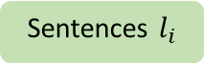

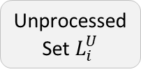

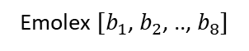
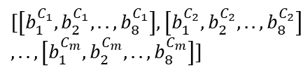
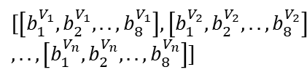
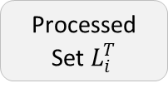
3. Image style transformation method (2/8)
3.2. Step 1: Lyrics preprocessing
User ’s Selected Lyrics
Step 1: Lyrics Preprocessing
Sentence Divider
Unprocessed Set $L_{i}^{U}$
Processed Set $L_{i}^{T}$
Sentences $l_{i}$
Verse/Chorus Extractor
Check the Repetition
Verses $L_{i}^{V_{n}}$
Choruses $L_{i}^{C_{m}}$
$$[\left[l_{1}^{V_{1}}, l_{2}^{V_{1}}, .. , l_{i}^{V_{1}}\right], \left[l_{1}^{V_{2}}, l_{2}^{V_{2}}, .. , l_{i}^{V_{2}}\right],.., \left[l_{1}^{V_{n}}, l_{2}^{V_{n}}, .. , l_{i}^{V_{n}}\right]]$$
$$[\left[l_{1}^{C_{1}}, l_{2}^{C_{1}}, .. , l_{i}^{C_{1}}\right], \left[l_{1}^{C_{2}}, l_{2}^{C_{2}}, .. , l_{i}^{C_{2}}\right],.., \left[l_{1}^{C_{n}}, l_{2}^{C_{n}}, .. , l_{i}^{C_{n}}\right]]$$
Emolex ${[b}_{1}$, $b_{2}$, .., $b_{8}]$
Compare
Probability Distribution of Emotion Word Extractor
Compare
The Number of Eight Basic Emotion Words
The Number of Eight Basic Emotion Words
$$[\left[b_{1}^{V_{1}}, b_{2}^{V_{1}}, .. , b_{8}^{V_{1}}\right], \left[b_{1}^{V_{2}}, b_{2}^{V_{2}}, .. , b_{8}^{V_{2}}\right] \\ ,.., \left[b_{1}^{V_{n}}, b_{2}^{V_{n}}, .. , b_{8}^{V_{n}}\right]]$$
$$[\left[b_{1}^{C_{1}}, b_{2}^{C_{1}}, .. , b_{8}^{C_{1}}\right], \left[b_{1}^{C_{2}}, b_{2}^{C_{2}}, .. , b_{8}^{C_{2}}\right] \\ ,.., \left[b_{1}^{C_{m}}, b_{2}^{C_{m}}, .. , b_{8}^{C_{m}}\right]]$$
softmax
Probability Distributions of Emotion Words $U^{V}$
Probability Distributions of Emotion Words $U^{C}$
$$\left[B^{V_{1}},B^{V_{2}}, ..,B^{V_{n}}\right]$$
$$\left[B^{C_{1}},B^{C_{2}}, ..,B^{C_{m}}\right]$$

Slide 13
3. Image style transformation method (3/8)
3.2. Step 1: Lyrics preprocessing
Sentence divider
Sentence Divider divides lyrics into sentences.
The lyrics are divided into a set of sentences considering capital letters.
Verse/chorus extractor
Verses/Choruses Extractor extracts verses and choruses from the user’s selected lyrics.
The set of sentences with no repetition in the lyrics as verse and the set of sentences that are repeated in the lyrics are classified as chorus.
User ’s Selected Lyrics
Emolex (Emotion Dictionary)
The Proposed Method
Step 1: Lyrics Preprocessing
Sentence Divider
Sentences
Verse/ Chorus Extractor
Verses/ Choruses
Probability Distribution of Emotion Word Extractor
Probability Distributions of Emotion Words

Slide 14
3. Image style transformation method (4/8)
3.2. Step 1: Lyrics preprocessing
Probability distribution of emotion word extractor
The Probability Distribution of Emotion Words Extractor compares the verses and choruses, with the Emolex (Emotion Dictionary) [20] and find the matching emotion words.
The extracted emotion words in each verse and chorus are replaced to the classified basic emotion words, and outputs probability distribution of basic emotion words.
User ’s Selected Lyrics
Emolex (Emotion Dictionary)
The Proposed Method
Step 1: Lyrics Preprocessing
Sentence Divider
Sentences
Verse/ Chorus Extractor
Verses/ Choruses
Probability Distribution of Emotion Word Extractor
Probability Distributions of Emotion Words

Slide 15
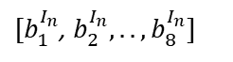
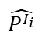
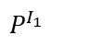
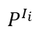
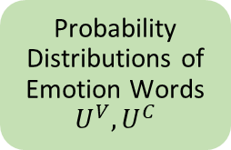
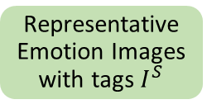
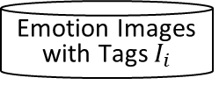
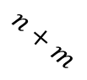
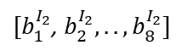
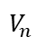
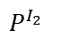
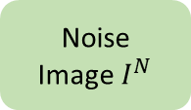
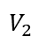
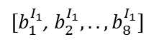
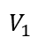
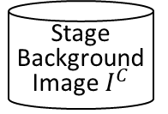
3. Image style transformation method (5/8)
3.3. Step 2: Emotion image processing
Emotion Images with Tags $I_{i}$
Step 2: Emotion Image Processing
Count the number of emotion words in tags
Representative Emotion Image Selector
$$P^{I_{1}}$$
$[b_{1}^{I_{1}}$, $b_{2}^{I_{1}},..,b_{8}^{I_{1}}]$
$$V_{1}$$
Probability Distributions of Emotion Words ${U^{V}, U}^{C}$
$[b_{1}^{I_{2}}$, $b_{2}^{I_{2}},..,b_{8}^{I_{2}}]$
$$V_{2}$$
Compare
$$P^{I_{2}}$$
softmax
…
…
…
$$P^{I_{i}}$$
$[b_{1}^{I_{n}}$, $b_{2}^{I_{n}},..,b_{8}^{I_{n}}]$
$$V_{n}$$
Select Image of Similar Probability Distribution
$$\hat{P^{I_{i}}}$$
Stage Background Image $I^{C}$
Representative Emotion Images with tags $I^{S}$
$$n+m$$
Representative Emotion Image Style Transfer
Images with Representative Emotion Images Style Transferred
…
Noise Image $I^{N}$

Slide 16
3. Image style transformation method (6/8)
3.3. Step 2: Emotion image processing
Representative emotion image selector
The Representative Emotion Images Selector selects emotion images with tag similar to probability distributions contained in each verse and chorus in the lyrics preprocessing step.
First, 1,000 images downloaded from Flickr and tagged eight basic emotion words through peer evaluation.
Second, the probability distribution of each image's emotion words is calculated.
Finally, images which have most similar probability distributions contained in the lyrics preprocessing step are selected.
Emotion Images with Tags
Stage background image
The Proposed Method
Step 2: Emotion Image Processing
Probability Distributions of Emotion Words
Representative Emotion Image Selector
Representative Emotion Images with Tags
Representative Emotion Image Style Transfer
Images with Representative Emotion Images Style Transferred
Noise Images

Slide 17
3. Image style transformation method (7/8)
3.3. Step 2: Emotion image processing
Representative emotion image style transfer
The Representative Emotion Images Style Transfer transfer the styles of emotion images with tags derived from the Representative Emotion Images Selector through a CNN model-based style transfer algorithm to the stage background image.
Content features should have location information of objects included in content image and edge information of the object, and the style feature is the correlation of feature maps. The content features and the style features jointly minimize the distance from the features of noise image
Emotion Images with Tags
Stage background image
The Proposed Method
Step 2: Emotion Image Processing
Probability Distributions of Emotion Words
Representative Emotion Image Selector
Representative Emotion Images with Tags
Representative Emotion Image Style Transfer
Images with Representative Emotion Images Style Transferred
Noise Images

Slide 18


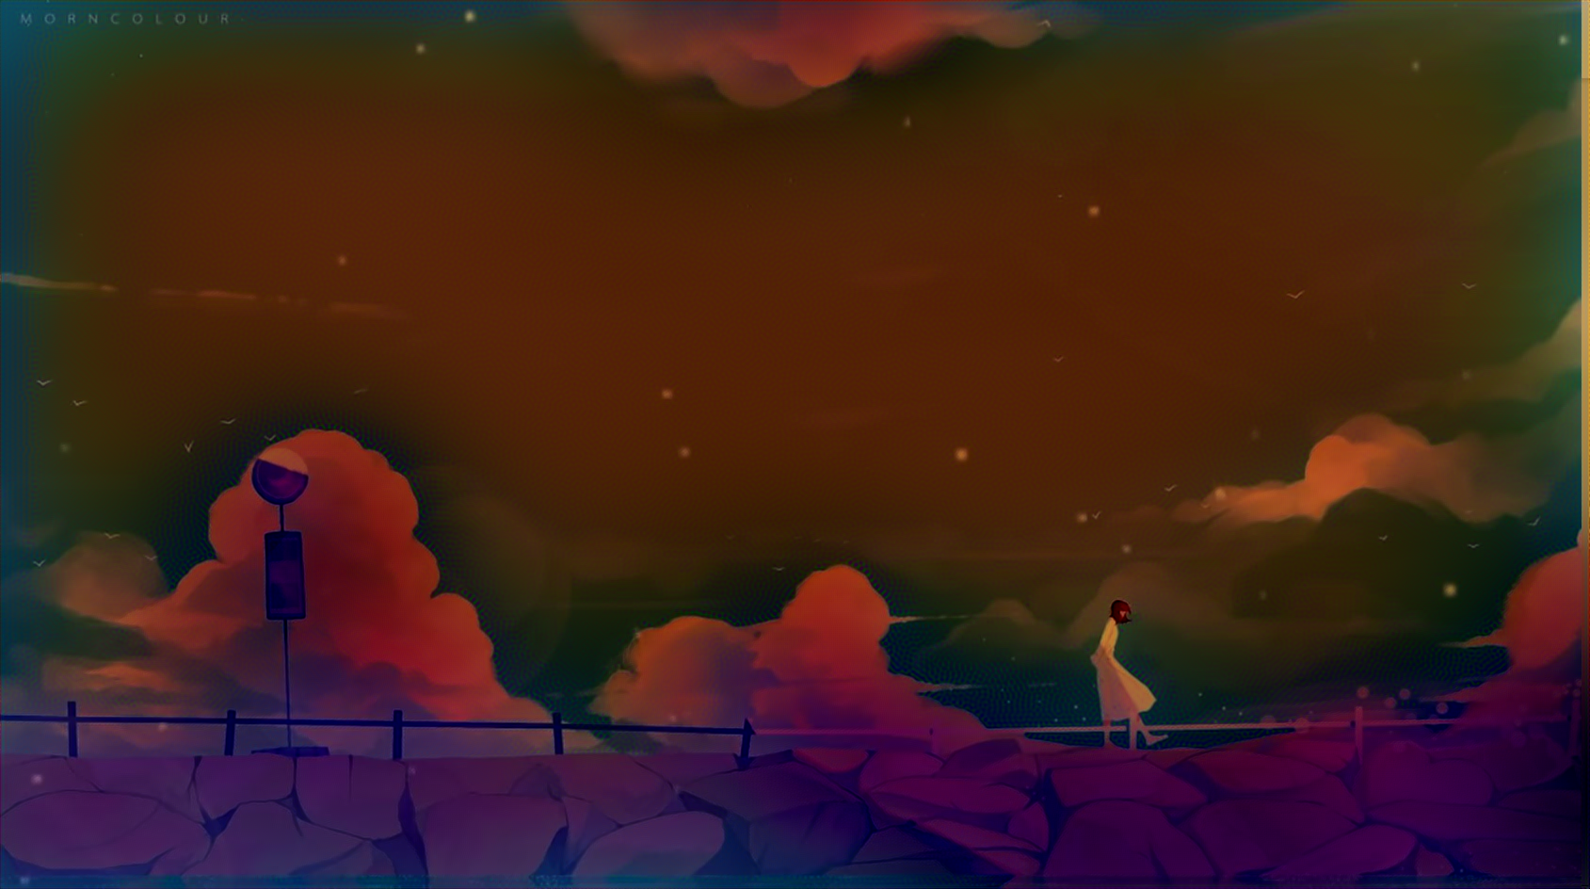


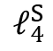
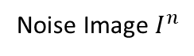
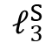
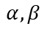
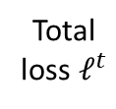
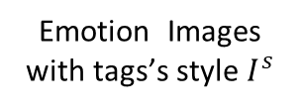
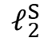
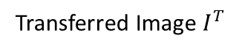
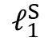
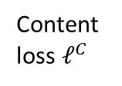
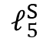
3. Image style transformation method (8/8)
3.3. Step 2: Emotion image processing
Representative Emotion Image Style Transfer
Stage background Image $I^{C}$
Content loss $ℓ^{C}$
Sobel Edge Detector
Total loss $ℓ^{t}$
Noise Image $I^{n}$
$$α,β$$
1st
2nd
3rd
4th
5th
Transferred Image $I^{T}$
Style losses
$$ℓ_{1}^{S}$$
$$ℓ_{2}^{S}$$
$$ℓ_{3}^{S}$$
$$ℓ_{4}^{S}$$
$$ℓ_{5}^{S}$$
Emotion Images with tags’s style $I^{s}$
1st
2nd
3rd
4th
5th

Slide 19
4. Experiments (1/10)
4.1. Datasets and experimental environment
Datasets
NRC Word-Emotion Association Lexicon (Emolex)
1,000 abstract images from Unsplash images
Experimental environment
Window10
i7–7700 CPU
NVIDIA TITAN RTX (24 GB)
DDR4 RAM(40GB)
<Table 2-1> Emotion word distribution of Emolex
 | Anger | Disgust | Fear | Sadness | Anticip-ation | Joy | Surprise | Trust
Quantity | 3428 (16%) | 3414 (15%) | 3572 (17%) | 3449 (15%) | 2312 (6%) | 2325 (10%) | 2625 (10%) | 2692 (11%)

Slide 20
4. Experiments (2/10)
4.2. Experiment results
The results of verse/chorus extractor
User’s Selected Lyrics
Verse/Chorus Extractor
Verses/Choruses
Her alarm goes off / And she gets up to watch the morning news / Doesn't work no more / But tells a lot of stories 'bout her youth / Drinks more lately And got pills in many different colors too / Morning light is showing / She moves the chair to look out at her view / But a shop was built right across the
the nurse that helps her / Move the chair to look out at the sun / But a shop was
I just hope their stories will still be told
Her alarm goes off
Verse1 Her, alarm, goes, off, And, she, gets, up, to, watch, the, morning, news, Doesn’t, work, no, more ------------------------------------------
Chorus1 But, a, shop, was, built, right, across, the, street, And, it, stands, were, the, sunrise, used, ------------------------------------------
Verse2 Our, heroes, oh, they, got, old, Our, heroes, oh, they, got, old, Smiles, they, fade, because, ------------------------------------------
.
.
.
Check repeated sentences
Unmatch
.
.
.
But a shop was built right across the street
.
.
.
.
.
.
.
.
.
Check repeated sentences
Match
.
.
.
But a shop was built right across the street
.
.
.
.
.
.

Slide 21
4. Experiments (3/10)
4.2. Experiment results
The results of probability distribution of emotion word extractor
Verses/Choruses
Probability Distribution of Emotion Word Extractor
Probability Distributions of Emotion Words
Verse1
Verse1 Her, alarm, goes, off, And, she, gets, up, to, watch, the, morning, news, Doesn’t, work, no, more
Chorus1 But, a, shop, was, built, right, across, the, street, And, it, stands, were, the, sunrise, used,
Verse2 Our, heroes, oh, they, got, old, Our, heroes, oh, they, got, old, Smiles, they, fade, because,
Alarm
Total Emotion Words: 14
Fear, Surprise
7.7%
15.4%
23.1%
7.7%
Watch
Anger : 1 / 14
Anticip : 2 / 14
Fear : 3 / 14
Joy : 1 / 14
Anticip, Fear
Youth
Anger, Anticip, Fear, Joy, Surprise
.
.
.
.
.
.
.
.
.
---------------------------------------------------------------------------------------------------------------------------------------------------------
Total Emotion Words: 75
Built
Chorus1
Anticip, Joy, Surprise, Trust
20.0% 6.7%
20.0%
13.3%
Right
Anticip : 15 / 75
Fear : 5 / 75
Joy : 15 / 75
Sadness : 10 / 75
Anticip, Joy, Surprise, Trust
Stands
Anticip, Joy, Surprise, Trust
.
.
.
.
.
.
.
.
.
---------------------------------------------------------------------------------------------------------------------------------------------------------
Total Emotion Words: 27
Hero
Verse1
Anticip, Joy, Surprise, Trust
Anger : 1 / 27
Anticip : 4 / 27
Disgust : 1 / 27
Fear : 1 / 27
3.7% 14.8%
3.7%
3.7%
Old
Sadness
Smile
Joy, Surprise, Trust
.
.
.
.
.
.
.
.
.
---------------------------------------------------------------------------------------------------------------------------------------------------------
.
.
.

Slide 22
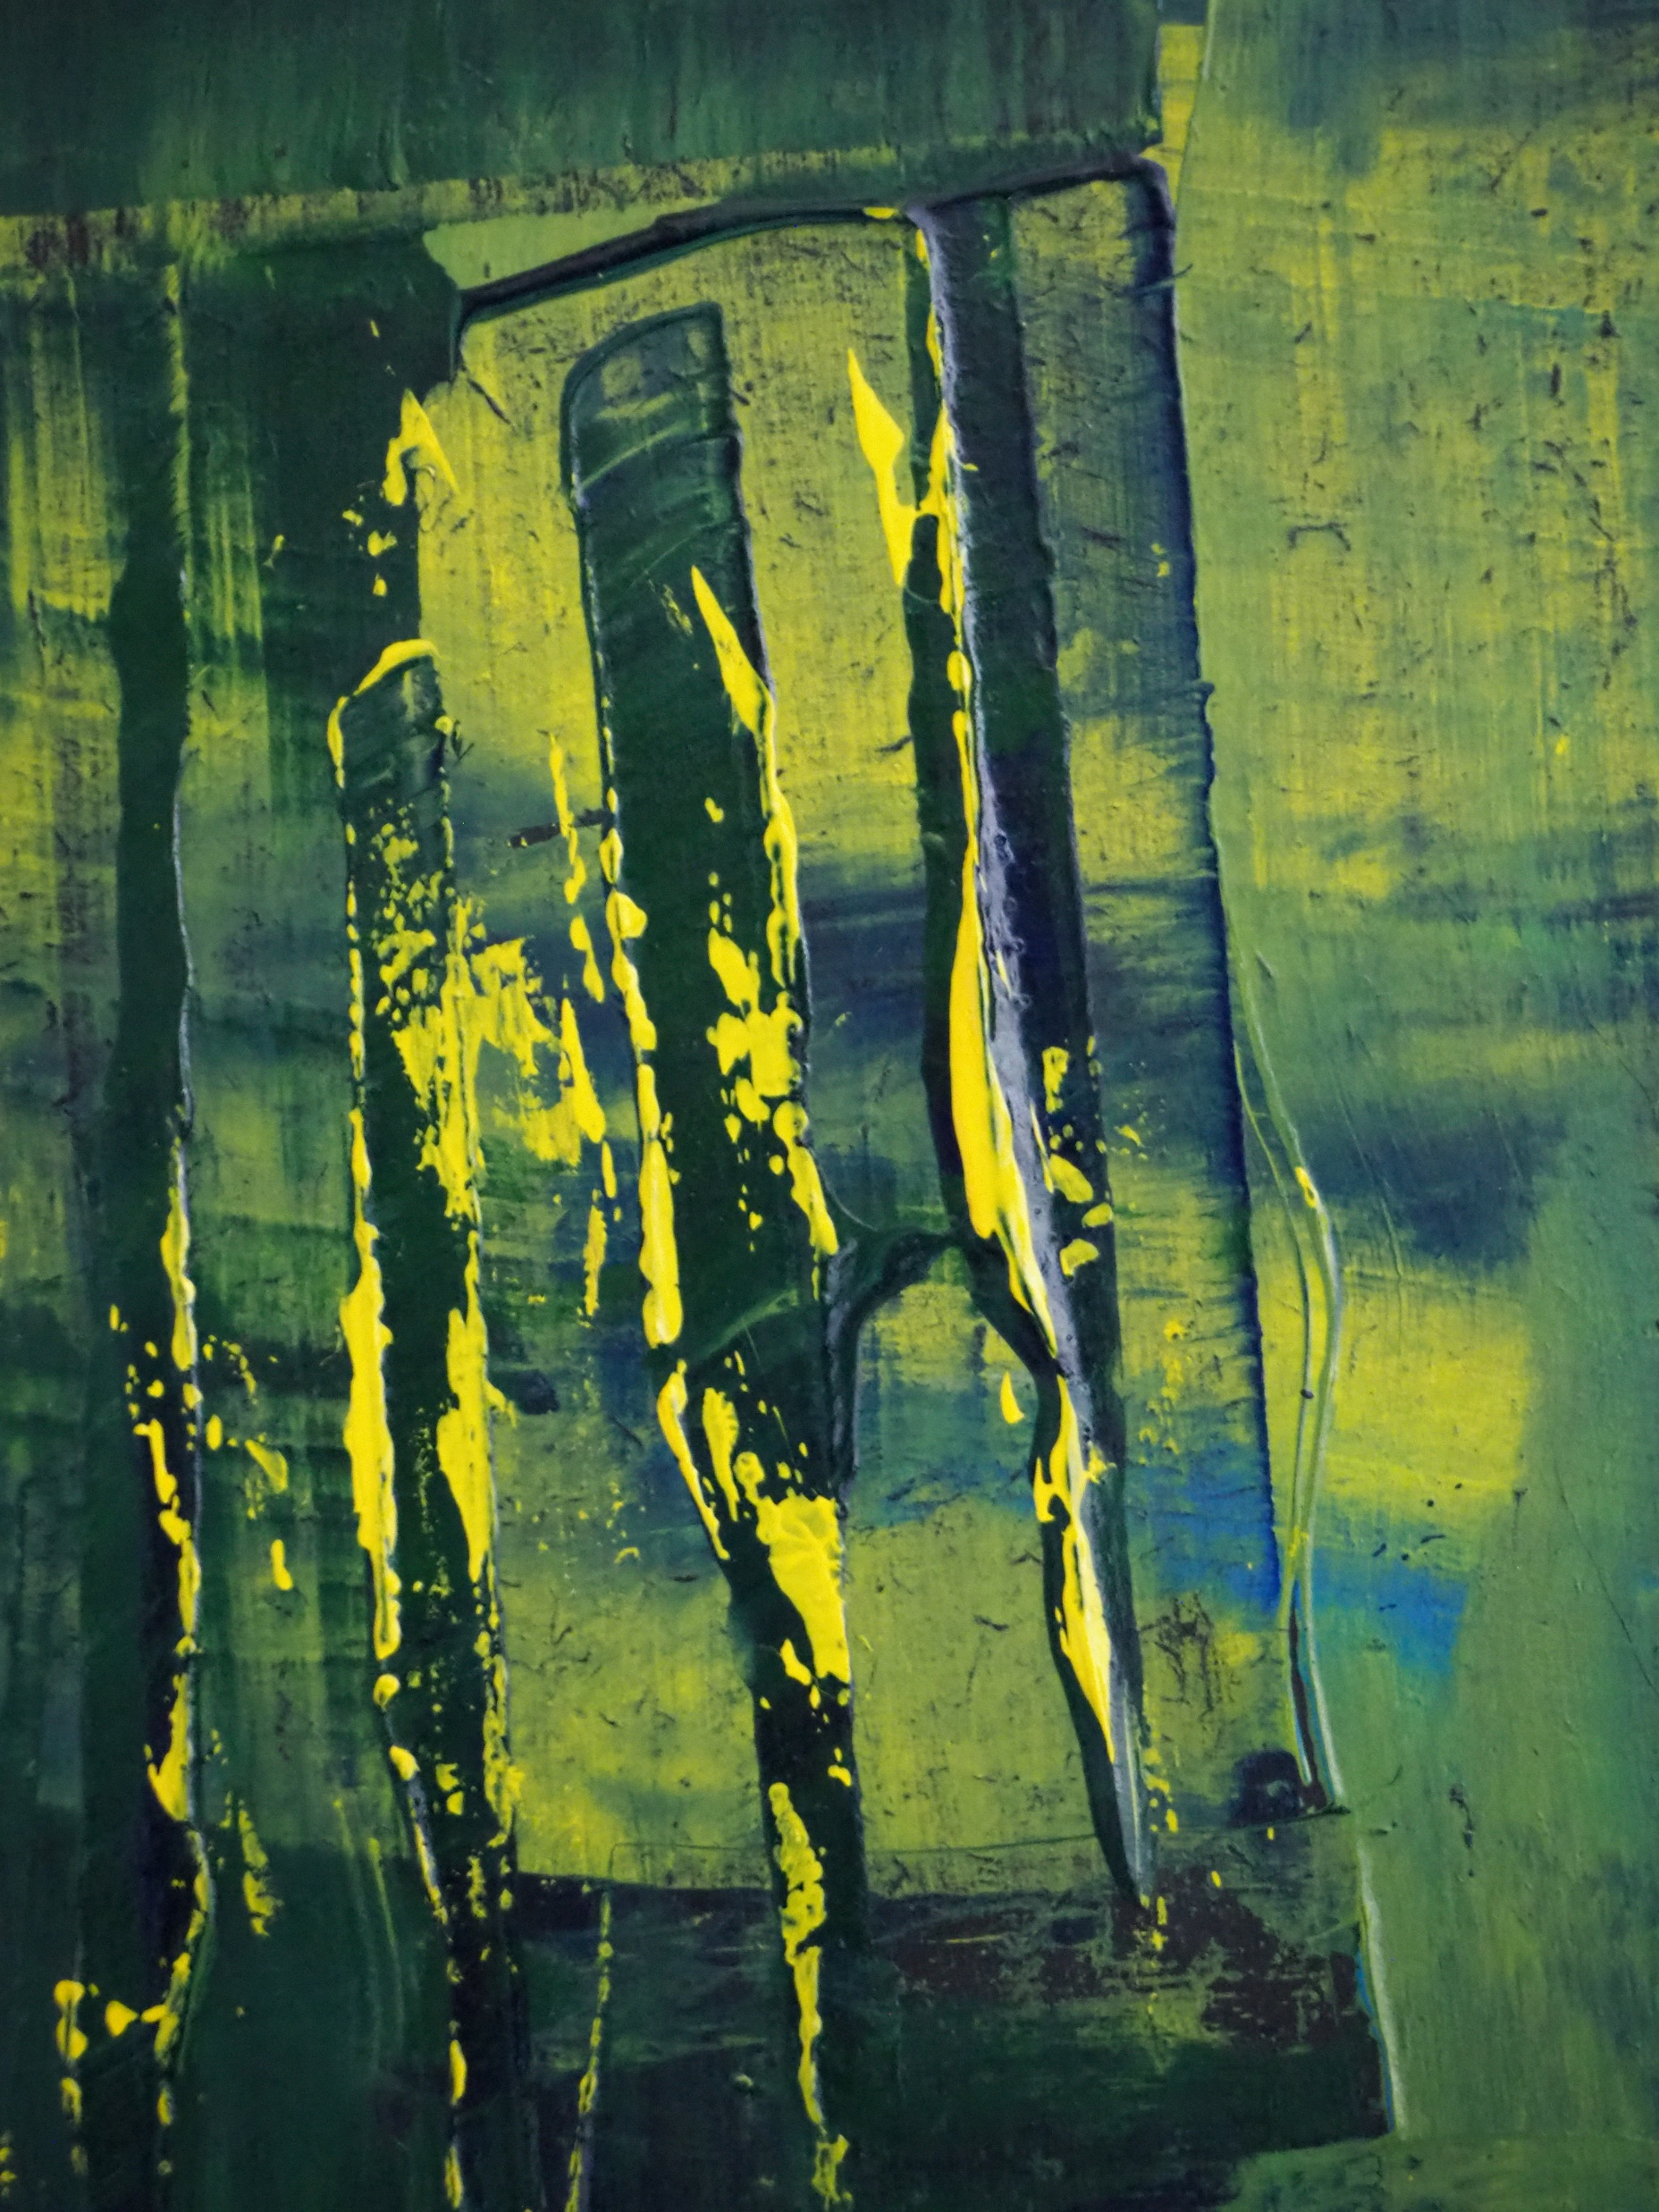
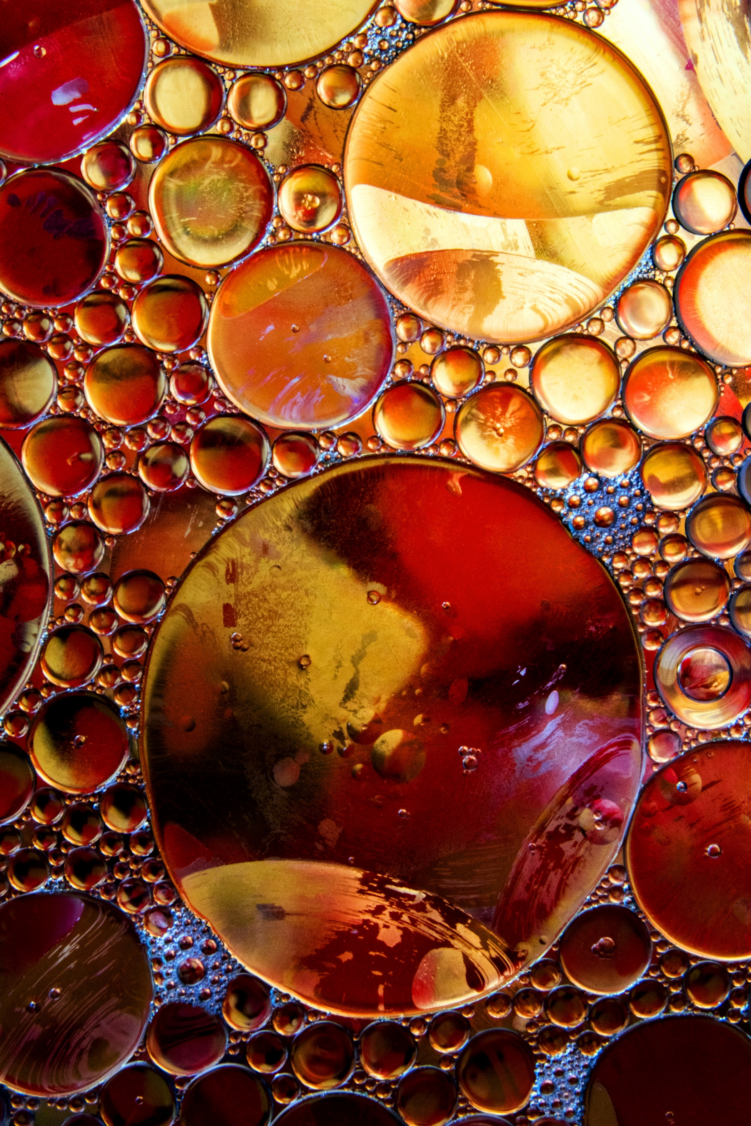
4. Experiments (4/10)
4.2. Experiment results
The results of representative emotion image selector
Probability Distributions of Emotion Words
Emotion Images with Tags
Verse1
Total Emotion Words: 14
Anger : 1 / 14
Anticip : 2 / 14
Fear : 3 / 14
Joy : 1 / 14
7.7%
15.4%
23.1%
7.7%
Awe：1
Disgust : 1
Fear：2
Sad：3
.
.
.
----------------------------------------------------
Total Emotion Words: 75
Chorus1
Awe : 1
Anger : 1
Amusement : 1
Content : 2
Disgust : 1
Sad : 1
Anticip : 15 / 75
Fear : 5 / 75
Joy : 15 / 75
Sadness : 10 / 75
20.0% 6.7%
20.0%
13.3%
Representative Emotion Image Selector
Match
.
.
.
Select the images of most similar probability distribution
----------------------------------------------------
Total Emotion Words: 27
Amusement : 1 Awe : 1
Content : 2
Excitement : 1
Sad : 1
Verse1
Anger : 1 / 27
Anticip : 4 / 27
Disgust : 1 / 27
Fear : 1 / 27
3.7% 14.8%
3.7%
3.7%
Match
.
.
.
.
.
.

Slide 23
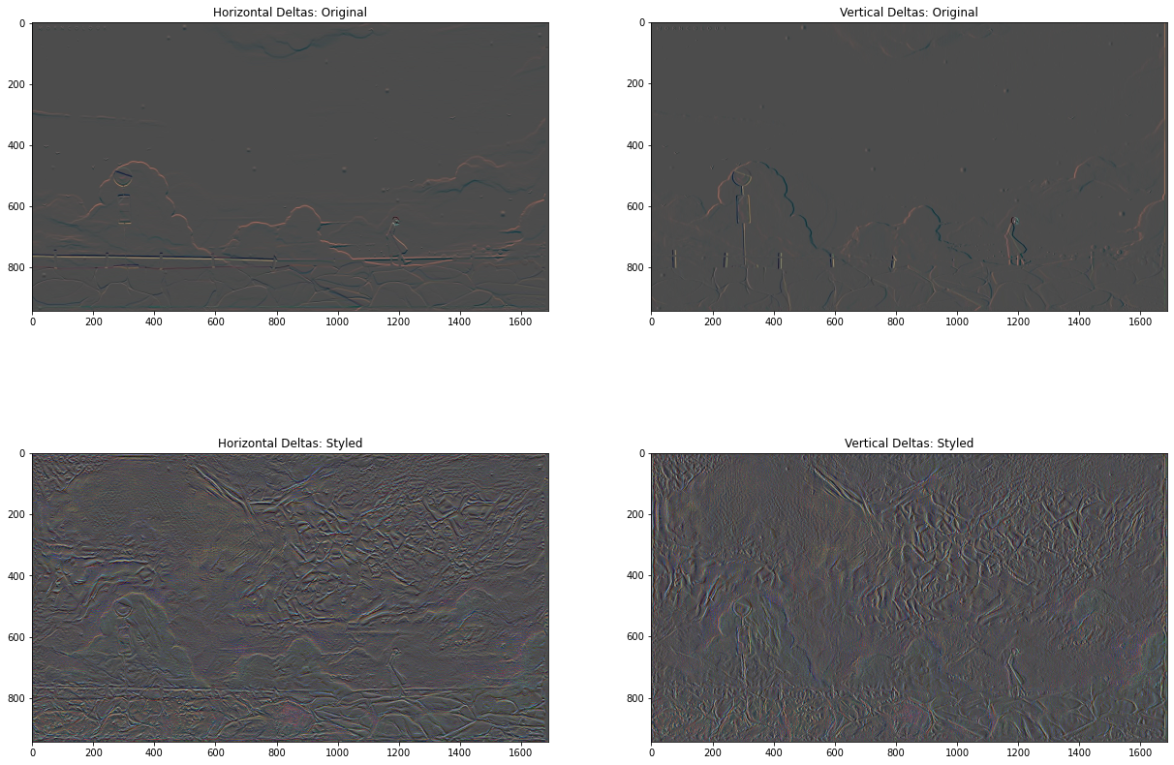
4. Experiments (5/10)
4.2. Experiment results
The results of representative emotion image style transfer

Slide 24
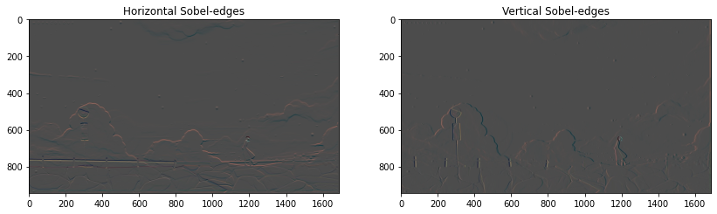
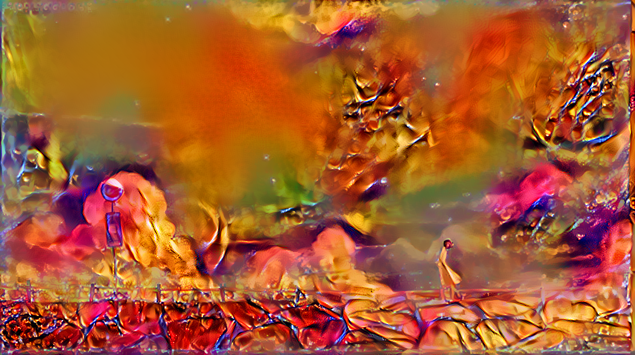
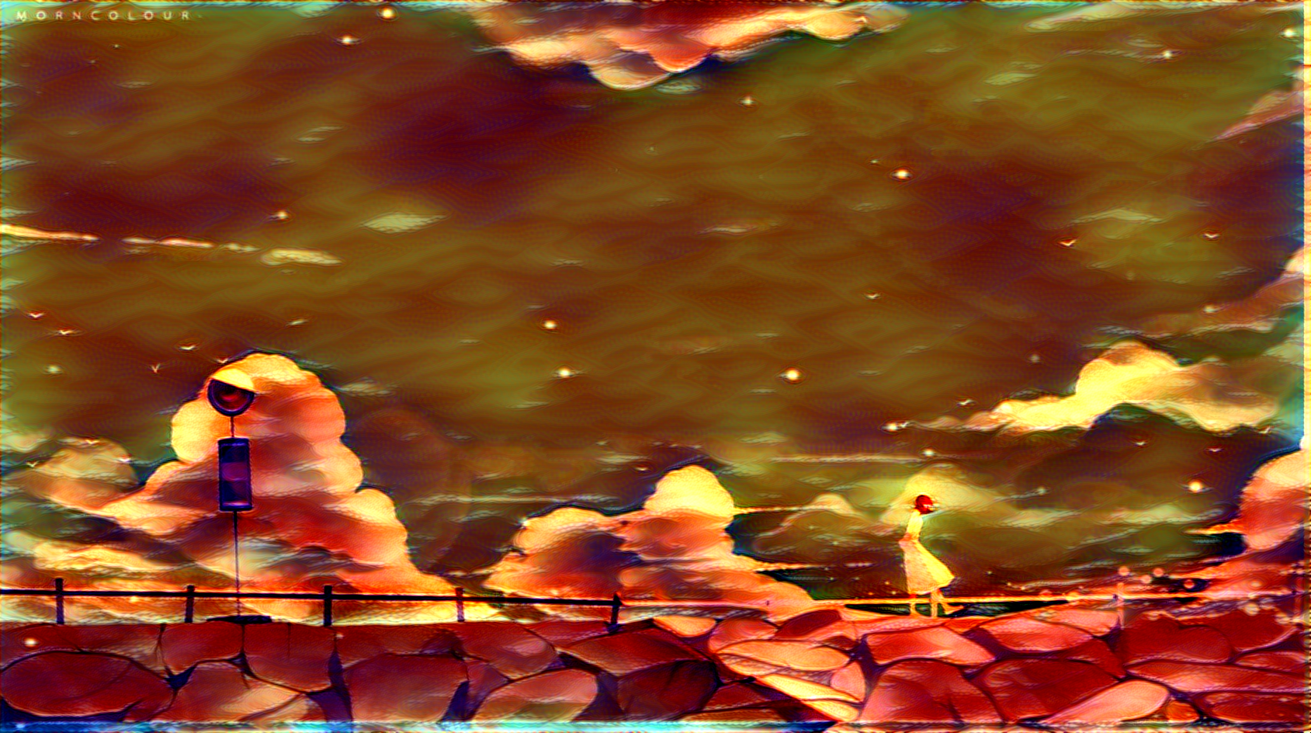
4. Experiments (6/10)
4.2. Experiment results
The results of representative emotion image style transfer

Slide 25





4. Experiments (7/10)
4.2. Experiment results
The training results of representative emotion image style transfer
Final Objective Function
Content loss $ℓ^{C}$and style loss $ℓ^{S}$
$$ℓ^{T}= αℓ^{C}+ βℓ^{S}$$
$$ℓ^{C}={\left\|\left.B_{2}\left(I^{N}\right)−B_{2}(I^{C}\right)\right\|}^{2}$$
$$ℓ^{S}=\sum_{n=1}^{5}{{\left\|\left.B_{n}\left(I^{N}\right)−B_{n}(I^{S}\right)\right\|}^{2}}$$

Slide 26


4. Experiments (8/10)
4.2. Experiment results
The results of emotion image processing
Input image |  | Style image | Emotion proportion | Output
 | Verse1 |  | Anticip : 20.0% Fear : 6.7% Joy : 20.0% Sadness : 13.3% Surprise : 20.0% Trust : 20.0%
 |  |  | Anger : 7.7% Anticip : 15.4% Fear : 23.1% Joy : 7.7% Sadness : 7.7% Surprise : 23.1% Trust : 15.4%
 | Chorus1

Slide 27








4. Experiments (9/10)
4.2. Experiment results
The validation results of proposed method
Original Img | Comparison Img (a) | Comparison Img (b) | Comparison Img (c)
Amusement: 0.14 Awe: 0.14 Content: 0.29 Excitement: 0.29 Sad: 0.14 | Amusement: 0.14 Awe: 0.29 Content: 0.29 Excitement: 0.14 Sad: 0.14 | Amusement: 0.29 Awe: 0.14 Content: 0.29 Excitement: 0.29 | Anger: 1.00
1.00 | 0.12 | 0.22 | 0.1
0.00 | 7665.83 | 7443.83 | 17372.30
1.00 | 0.38 | 0.28 | 0.05
0.00 | 0.62 | 0.62 | 0.92
Emotion Probability Distribution
Correlation
CHISQR
Intersection
Bhattacharyya

Slide 28

4. Experiments (10/10)
4.2. Experiment results
The results of proposed method
Verse1
Chorus
Verse2
Verse3

Slide 29
5. Conclusion
Proposed method
This paper proposed a method to transfer a styles extracted based on the emotion words included for each verse and chorus of selected lyrics by a user to stage background image.
Through the proposed method, the appropriate stage background images can be used for stage performance using the lyrics without designers.
The styles was transferred to the stage background image without losing content information. Experimental results showed that the proposed method reduced total variation loss from 1.07773870080 to 0.15971347456 while maintaining the edge information of the content image and transferring new styles.
Also, stage background image and images of transferred styles with similar emotion words probability distributions were 38% similar, and stage background image and image of transferred styles with completely different probability distributions were 8% similar.
In the future, we will analyze lyrics through Natural Language Processing(NLP) rather than relying solely on the emotion words dictionary to improve the accuracy of the emotion probability distribution.

Slide 30
References
[1] Li, S., Jang, S., Sung, Y, “Melody Extraction and Encoding Method for Generating Healthcare Music Automatically,” Electronics, Vol. 8(11), pp. 1250-1265, 2019.
[2] Li, S., Jang, S., Sung, Y, “Automatic Melody Composition Using Enhanced GAN,” Mathematics, Vol. 7(10), pp. 883-896, 2019.
[3] Ahmed, E., Liu, B., Mohamed, E., Mazzone, M., “CAN: Creative Adversarial Networks, Generating "Art" by Learning About Styles and Deviating from Style Norms,” arXiv preprint arXiv:1706.07068, 2017.
[4] Wen, J., She, J., Li, X., Mao, H, “Visual Background Recommendation for Dance Performances Using Deep Matrix Factorization,” ACM Transactions on Multimedia Computing, Communications, and Applications (TOMM), Vol. 14, pp. 1-19, 2018.
[4] Xu, T., Zhang, P., Huang, Q., Zhang H., Gan, Z., Huang, X., He, X, “AttnGAN: Fine-Grained Text to Image Generation with Attentional Generative Adversarial Networks,” In the Proceedings of the IEEE conference on Computer Vision and Pattern Recognition (CVPR), Salt Lake City, USA, June 18-22, 2018.
[5] Zhang , H., Xu , T., Li, H., Zhang, S., Wang, X., Huang, X., Metaxas, N. D, “Stackgan++: Realistic Image Synthesis with Stacked Generative Adversarial Networks,” IEEE Transactions on Pattern Analysis and Machine Intelligence, Vol. 41, pp. 1947-1962, 2019.
[6] Hu, X., Downie, J. S., Ehmann, A, "Lyric text mining in music mood classification," American Music, Vol. 183(5,049), pp.2-209, 2009.
[7] Karras, T., Laine, S., Aila, T, “A Style-Based Generator Architecture for Generative Adversarial Networks,” In: Proceedings of the IEEE/CVF Conference on Computer Vision and Pattern Recognition, Long Beach, USA, June 16-20, 2019.
[8] Hori, G., "Color Extraction from Lyrics," In Control and Robotics Engineering (CACRE), Shenzhen, pp. 1-6, July 19-20, 2019.
[9] Isola, P., Zhu, J., Zhou, T., Efros, A. A, “Image-to-Image Translation with Conditional Adversarial Networks”, In: Proceedings of the IEEE conference on computer vision and pattern recognition, Honolulu, USA, July 21-26, 2017.
[10] Sung, Y., Jin, Y., Kwak, J., Lee, S., Cho, K, “Advanced Camera Image Cropping Approach for CNN-Based End-to-End Controls on Sustainable Computing,” Sustainability, Vol. 10(3), pp. 816-828, 2018.
[11] Gatys, A, L., Ecker, A. S., Bethge, M, “Image Style Transfer Using Convolutional Neural Networks,” In: Proceedings of the IEEE conference on computer vision and pattern recognition, Las Vegas, USA, June 27-30, 2016.
[12] Zhao, S., Gao, Y., Jiang, X., Yao, H., Chua, T., Sun, X, “Exploring Principles-of-Art Features For Image Emotion Recognition,” In: Proceedings of the 22nd ACM international conference on Multimedia, June 18-19, 2014.
Emotion Identification from Lyrics," In IEEE International Symposium on Multimedia (ISM), San Diego, pp. 624-629, 2009.
[13] Machajdik, J., Hanbury, A, “Affective Image Classification using Features Inspired by Psychology and Art Theory,”In: Proceedings of the 18th ACM international conference on Multimedia, Florence, USA, October 25-29, 2010.

Slide 31
References
[14] Han, E., Cha, H, “Extraction of Critical Low-Level Image Features for Effective Emotion Analysis,” Institute of Control, Vol. 25(4), pp. 319-326, 2019.
[15] Wei, Z., Zhang, J., Lin, Z., Lee, J., Balasubramanian, N., Hoai, M., Samaras, D, "Learning Visual Emotion Representations from Web Data," In: Proceedings of the IEEE/CVF Conference on Computer Vision and Pattern Recognition, Seattle, USA, June 13-19, 2020.
[16] Yang, D., Lee, W, "Music
[15] Zhang , H., Xu , T., Li, H., Zhang, S., Wang, X., Huang, X., Metaxas, N. D, “Stackgan++: Realistic Image Synthesis with Stacked Generative Adversarial Networks,” IEEE Transactions on Pattern Analysis and Machine Intelligence, Vol. 41, pp. 1947-1962, 2019.
[16] Yang, D., Lee, W, "Music Emotion Identification from Lyrics," In IEEE International Symposium on Multimedia (ISM), San Diego, pp. 624-629, 2009.
[17] Zhao, S,. Yao, H., Gao, Y., Ding, D., Chua, T, “Predicting Personalized Image Emotion Perceptions in Social Networks,” IEEE Transactions on Affective Computing, Vol. 9(4), pp. 526-540, 2018.
[18] Lee, J., Lim, H., Kim, H, “Similarity Evaluation of Popular Music based on Emotion and Structure of Lyrics,” KIISE Transactions on Computing Practices, Vol. 22, pp. 479-487, 2016.
[19] Mohammad, S. M., Turney, P. D, "Emotions evoked by common words and phrases: Using Mechanical Turk to create an emotion lexicon," In: Proceedings of the NAACL HLT 2010 workshop on computational approaches to analysis and generation of emotion in text, Los Angeles, USA, June 5, pp. 26-34, 2010.
[20] NRC Word-Emotion Association Lexicon. Available online: http://saifmohammad.com/WebPages/NRC-Emotion-Lexicon.htm (accessed on December 31, 2020)
[21] Zhu, C., Richard H. B., Lu, P, “Algorithm 778: L-BFGS-B: Fortran subroutines for large-scale bound-constrained optimization,” ACM Transactions on Mathematical Software (TOMS), Vol. 23(4), pp. 550-560, 1997.
[22] Gao, W., Zhang, X., Yang, L., Liu, H, “An improved Sobel edge detection,” In: 2010 3rd International conference on computer science and information technology, Chengdu, China, July 9-11, Vol. 5, pp. 67-71, 2010.
[23] Ogul, H., Celik, N,, “A Web Application for Content based Geographic Image Retrieval,” In: 2017 25th Signal Processing and Communications Applications Conference (SIU), Antalya, Tulkey, May 15-18, pp. 1-4, 2017.
[24] Choi, E., Lee, C., “Feature extraction based on the Bhattacharyya distance,” Pattern Recognition, Vol. 36(8), pp. 1703-1709, 2003.

Slide 32


